Slide 1
Recitation#2
TA: Tatheer Zahra (tzz5184@psu.edu)

Slide 2
Important Announcements
Grades for L.1 have been uploaded.
L.2 is due 08/2 (This Friday). Submissions after 5 will have a 10% deduction.
Please check Canvas for announcements from Dan Kahn.
T.2 would be in next recitation and would include material from Module 1 and Module 2.

Slide 3
Feedback from L.1
Usage of input and sqrt functions/other built-in functions.
Name your files correctly and include header as well.
Learn how to write a mathematical equation in one line.
Using variables in equations rather than values.
Follow the instructions from the lab description.

Slide 4
Review on Module 2
Types of functions:
Input and no output
No input and no output
Input and output
No input and output
Define local variable:
Variable defined inside of a function
Calling stack:
A stack is created whenever a function is called inside of another function.

Slide 5
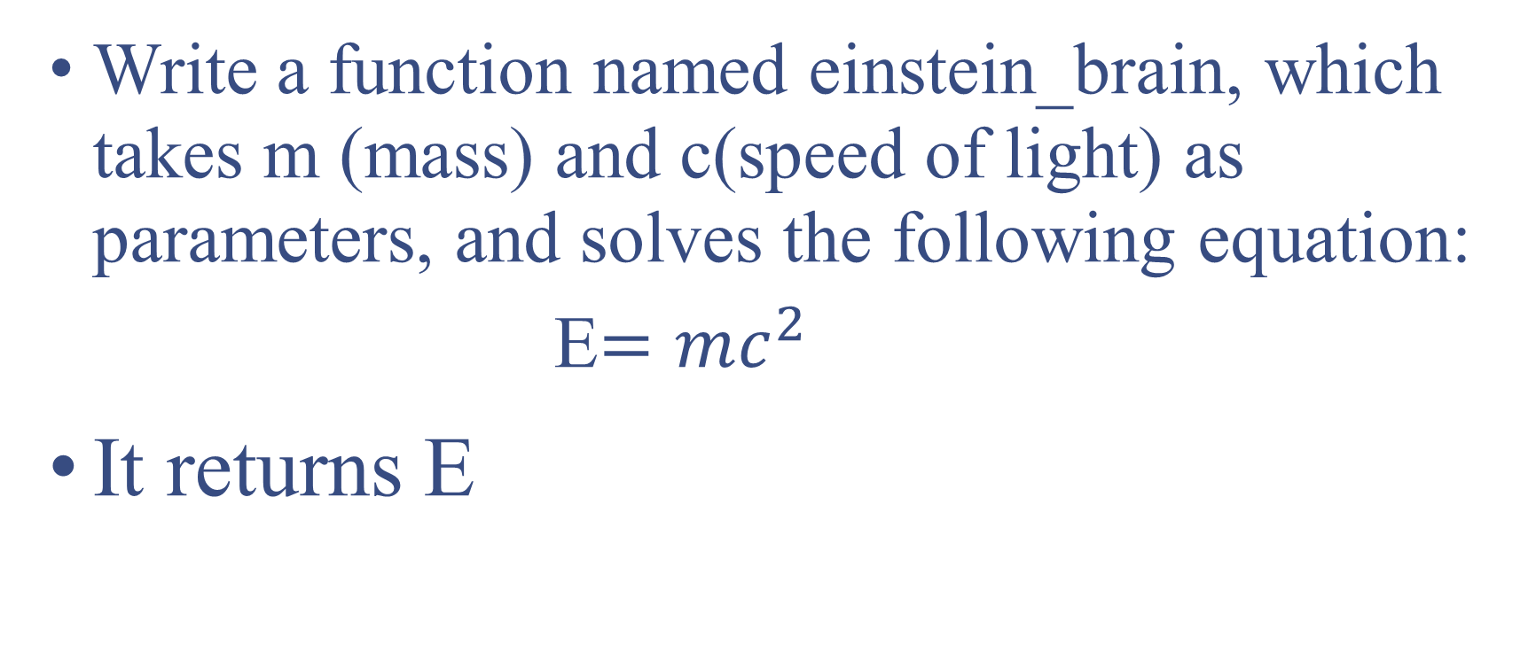
Practice Problem#1
Write a function named einstein_brain, which takes m (mass) and c(speed of light) as parameters, and solves the following equation:
E$=mc^{2}$
It returns E

Slide 6
Practice Problem#2
Write a function named multiplier that takes two numbers as parameters, multiplies the numbers and returns the result.

Slide 7
Prepare for timed test
Sign into canvas and pull up the recitation page on the lab computer ​​
Clear workspace (no notes, no phones, all away)​
You will hear me call out time warnings. Please manage your time!​​
Raise your hand if you have any questions ​​
Remember this timed test only covers material from Modules 1. NO functions!​​
Can refer to Syllabus “Important” section for prohibited constructs​
Don’t need comment header or specific file name (only for lab assignments)​
When you are done, take a picture of your submission page and sign out with the LA at the front.

Slide 8
Timed Test
Time test will be due in 15 minutes​​. You should mark your attendance after 15 minutes to be considered for grading.
Read the instructions carefully.
If you have a question, raise your hands.
Password: weARE

